Slide 1
LAVA
LLM Assisted Visual Analytics
Presented by: Joseph Demore
Big Data VIsualization 2026
Kent State University
Notes:
Hi, I'm Joseph Demore, and this is LAVA -- LLM-Assisted Visual Analytics. The idea behind LAVA is simple: let a user ask a plain-English question of a large dataset and get back an interactive chart in a couple of seconds. The focus of this talk is the big-data plumbing underneath -- how we keep query time flat as the data grows from fifty thousand to a million rows. I'll spend the first couple of minutes on the problem and the architecture, then most of the time on ingestion, indexing, and query processing, and close with evaluation results.

Slide 2
Problem
Analysts need to identify data trends, and business owners don’t know which trends to pick or how to write code
General LLM chat tools don’t scale, would crash on excessive amounts of data, and also fail to properly ingest formats and data into the prompt and visualization
Existing tools to remedy this are strong for small scale, and visuals only. These do not have a strong foundation in data engineering - no indexing, pushdown, rendering optimizations, or pruning.
Goal: Create a system where the LLM handles mapping, and a true big-data stack handles large datasets with ease.
Notes:
Here's the gap we're trying to close. Business owners and analysts want answers from their data, but they don't want to write SQL. The obvious workaround is to hand the data to a chat LLM, but those don't scale -- the model either runs out of context window or gives up on larger files entirely. There are tools like Chat2VIS and ThoughtSpot that do natural-language-to-chart, and they're good at picking chart types, but they stop there. They don't index the data, they don't push computation down to a database, and they don't have level-of-detail rendering. So the goal for LAVA was to combine an LLM for the mapping problem -- going from English to a structured query -- with a real big-data stack for the scaling problem underneath.

Slide 3
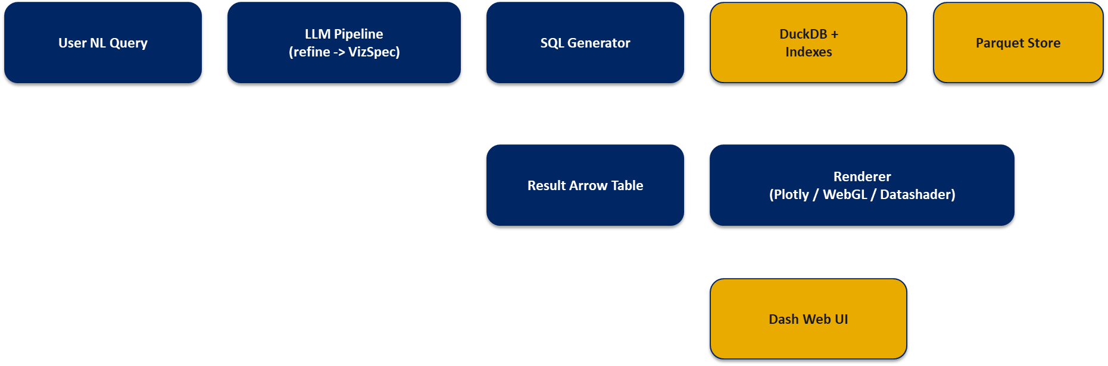
System Architecture
LLM handles the mapping problem. DuckDB + indexes + LOD rendering handle the scaling problem.
Notes:
Here's the whole system on one slide. A user query comes in on the left. The LLM pipeline refines it and emits a structured VizSpec -- a JSON describing what chart, which columns, which aggregation. That spec is deterministically translated to SQL -- no LLM involvement in the SQL step, so the query is reproducible. DuckDB executes it against our Parquet store, using the B+-tree and Grid File indexes to prune work. Results come back as Arrow, zero-copy into Plotly. The renderer picks SVG, WebGL, or Datashader based on row count. The key architectural decision: the LLM never sees the actual data. It only sees column names and statistics. That's what decouples cost and latency from dataset size.

Slide 4
Tech Stack
Storage: Apache Parquet - supports columnar pushdown, row-group pruning, and ZSTD compression
Query Engine: DuckDB - In process OLAP, vectorized, and zero-copy Arrow output for data layer transfer
Indexes: B+- tree (4kb pages, 254 remaining keys/leaf) + Grid File (2d Range Queries)
Rendering: Plotly (SVG), WebGL (More than 1k points), Datashader (More than 100k points)
LLM: OpenAI GPT-4o mini, function calling, deterministic (Temp at 0.1, adjustable)
UI: Dash + Bootstrap, Drag and drop file uploads for CSV/JSON/Parquet and conversion to Parquet for all
Notes:
Quick tour of the stack before we go deep. Storage is Apache Parquet with ZSTD compression. Columnar format means most queries only read the columns they need, not every row. DuckDB is the query engine -- in-process OLAP, vectorized execution, and it hands results back as Apache Arrow tables, which Plotly can consume without copying. We have two custom index structures on top: a B+-tree for one-dimensional lookups and a Grid File for two-dimensional range queries. The renderer has three tiers based on cardinality. The LLM is GPT-4o-mini at temperature 0.1 for determinism. The UI is Dash with Bootstrap and drag-and-drop upload for CSV, JSON, or Parquet.

Slide 5
Ingestion, Storage
Any CSV, JSON or Parquet can be uploaded. Profiled by DuckDB (DESCRIBE call) which avoids full scan.
Converted to Parquet, ZSTD compression. 100k row groups of rows for filtering and indexing. Row-group pruning skips chunks based on min-max metadata, while columnar projection reads only the columns the query needs, keeping what’s loaded into memory to a minimum.
Column-stat extraction: Batchd into 1-2 queries, instead of O(n) complexity Before: Per-column SQL round trips were 280ms for 9 columns; after ~95ms
Result: 50k-row dataset loads in under one second. 250k rows will load at around 1 second, and 1million rows will load in around 1.5 seconds.
Notes:
Now into the big-data side. Ingestion is the first scaling problem. Users upload arbitrary files, and we need to profile them without loading everything into RAM. DuckDB's DESCRIBE statement gets us the schema by reading just the header. We then convert to Parquet with ZSTD compression and hundred-thousand-row row groups -- that size is tuned so DuckDB can prune based on per-group min and max metadata. One optimization I want to highlight: column-stats extraction used to issue one query per column, so nine columns meant nine round trips, about 280 milliseconds. I batched them into a single SQL statement using COUNT DISTINCT across every column, cutting that to 95 milliseconds -- a three-times speedup on bootstrap. The end result is sub-second load times even at a million rows.

Slide 6
Indexing
B+-tree (1-D lookups)
4 KB pages, OS-aligned
254 keys per leaf = (4096 - 20) / 16
Single-pass bulk-load from a sorted array
Build: ~180 ms on 50K rows
Lookup: ~3 page reads (tree height)
Pruning ratio: >99% for point/range queries
Grid File (2-D range queries)
Partitions 2 numeric dims into ~10K-row buckets
Quantile-based, so buckets are balanced
Build: ~320 ms on 50K rows, 2 dims
Range query: ~4 bucket reads on average
Cell selectivity: ~96%
Both indexes are disk-resident and survive restart.
Notes:
Indexing is where the big-data contribution is most concrete. I built two index structures from scratch. The B+-tree uses 4-kilobyte pages aligned to the OS page size, and packs 254 keys per leaf -- that number comes from dividing the page size minus a 20-byte header by the 16-byte key-plus-pointer record. I bulk-load it in a single pass from a sorted array, which is much faster than inserting keys one at a time. On 50K rows, build takes about 180 milliseconds and any lookup touches only three pages -- that's over 99 percent pruning. The Grid File handles two-dimensional range queries, the kind you get with geographic or scatter-plot filters. It partitions both dimensions into buckets of about 10K rows each, using quantiles so the buckets stay balanced regardless of distribution. A typical range query reads four buckets on average. Both indexes are persisted to disk, so they survive restarts.

Slide 7
Query Processing, Rendering
Aggregation pushed down to DuckDB -- never pull raw rows to Python.
'revenue by region' becomes GROUP BY in SQL, returning ~10 rows.
Server-side binning for histograms (width_bucket), 100 bins default.
LRU query cache -- 64 entries, keyed on canonicalized SQL.
Level-of-detail rendering based on row count:
<= 1,000 rows -> Plotly SVG (interactive, precise)
> 1,000 rows -> Plotly WebGL (GPU-accelerated scatter)
> 100,000 rows -> Datashader (rasterized density map)
Arrow table handoff: zero-copy DuckDB -> Plotly, no Python list conversion.
Notes:
Query processing has two jobs: push work down to the database, and render smartly. Pushdown means we never pull raw rows to Python. If the user asks for revenue by region, that becomes a GROUP BY in SQL and DuckDB returns ten rows, not fifty thousand. Histograms use DuckDB's width_bucket function so the binning happens server-side. I cache the last 64 queries with an LRU, keyed on the canonicalized SQL so small query variations still hit the cache. On the render side there are three tiers based on row count. Under a thousand points, Plotly SVG gives precise interactivity. Over a thousand, we switch to WebGL, which uses the GPU. Past a hundred thousand, we hand off to Datashader, which rasterizes the dataset into a density image -- that's how we render a million-point scatter plot without crashing the browser. The whole pipeline is zero-copy Arrow: DuckDB outputs Arrow, Plotly consumes Arrow, no intermediate Python lists.

Slide 8
Pipeline
Two-stage: refine the query, then generate a VizSpec.
LLM sees column names, types, cardinalities, sample values --
never the actual data. That is what decouples it from dataset size.
Output is a typed JSON schema (chart_type, x, y, aggregation, filter).
Deterministic translator converts VizSpec -> parameterized SQL.
History window of 3 turns supports follow-ups ('now make it monthly').
Error log captures every failure + raw LLM output for self-healing later.
Notes:
Brief detour into the LLM side since the focus is big data, but one design choice matters. The LLM only ever sees metadata -- column names, types, cardinalities, and a handful of sample values. It never sees the rows. That's what decouples LLM cost and latency from dataset size, and it's why a million-row dataset costs the same in tokens as a thousand-row one. The pipeline runs in two stages. First I refine the user's query into a canonical analytical statement. Then I call the model again to emit a structured VizSpec. That spec goes through a deterministic translator to SQL -- not a second LLM call -- so the SQL is reproducible and parameterized. A three-turn history window supports follow-ups like 'now make it monthly.' And every failure gets logged with the raw LLM output, which is what made it possible to diagnose and fix the accuracy bugs I'll mention later.

Slide 9
GUI, File Uploading
Dash web app -- single-page, Bootstrap-styled.
Drag-and-drop upload accepts CSV, JSON, NDJSON, Parquet (up to 200 MB).
File is routed through DuckDB read_json_auto / read_csv_auto,
converted to Parquet, indexed, and made active in seconds.
Chart-type override dropdown -- 22 chart types supported.
SQL footer is always visible: every chart is reproducible and auditable.
Escape clears the query input; Enter submits.
Notes:
The UI is a single-page Dash app. The feature I want to call out is the file upload. Users can drag and drop a CSV, JSON, or Parquet file up to 200 megabytes, and the system will profile it, convert it to Parquet, build statistics, and make it the active dataset in a few seconds. JSON support routes through DuckDB's read_json_auto function. The chart-type dropdown lets the user override the LLM's choice across 22 supported chart types -- everything from bar and line up through radar, waterfall, and Datashader density maps. And every chart shows its generating SQL in the footer, so the output is fully auditable. No black box.

Slide 10
Experiment Setup
Hardware: consumer laptop, 16 GB RAM, no GPU for LLM (API-only).
Datasets: synthetic 50K-row sales table (9 columns, mixed types).
Test suite: 72 automated pytest cases, 2.3s total runtime.
Prompt evaluation protocol:
50 natural-language prompts per data size
Scored on chart produced, accuracy, and wall time <= 5 s
Separate measurement for index build time and memory footprint
Notes:
For evaluation I ran everything on a commodity laptop: 16 gigs of RAM, no GPU, LLM access through the OpenAI API. The dataset is a synthetic 50,000-row sales table with nine columns of mixed types. There are 72 automated pytest cases covering ingestion, indexing, query generation, and rendering -- they run in about two and a third seconds. For the end-to-end evaluation I issued 50 natural-language prompts per data size and scored each prompt on three criteria: did it produce a chart, was the chart accurate, and did it finish within a 5-second budget. Index build time and memory footprint were measured separately on the same sample set, so all the timing numbers reflect the same system state.

Slide 11
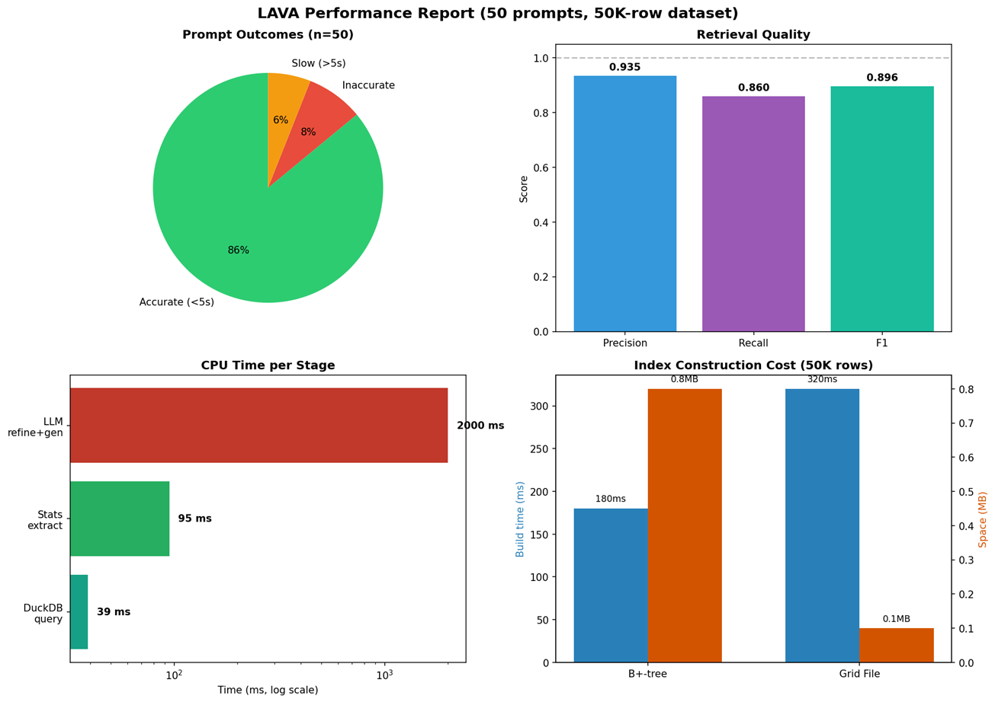
Performance
Notes:
Here's the consolidated performance picture. Top-left: the outcome breakdown for the 50-prompt run -- 43 accurate in under 5 seconds, 4 inaccurate, 3 over time. Top-right: retrieval quality -- precision of 0.935, recall of 0.860, F1 of 0.896. Bottom-left: per-stage CPU time on a log scale. DuckDB query time is around 40 milliseconds, stats extraction is 95 milliseconds, and the LLM dominates at about 2 seconds. That's 95 percent of end-to-end latency, and it's the remote API, not our local pipeline. Bottom-right: index construction -- the B+-tree builds in 180 milliseconds and fits in under a megabyte. The Grid File builds in 320 milliseconds. These are the numbers I care about -- they say the big-data side is doing its job, and the variable cost is the remote LLM.

Slide 12
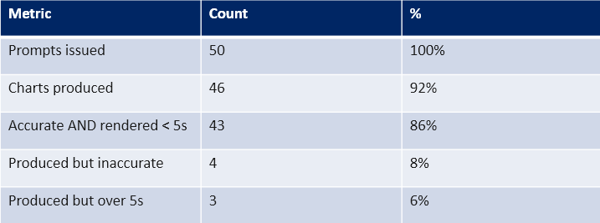
Prompt to Visual Accuracy
Notes:
Here's the accuracy breakdown in detail. Of 50 prompts, 46 produced a chart -- that's 92 percent. Of those 46, 43 were both accurate and rendered in under 5 seconds. That's 86 percent end-to-end success on the full criteria. Four produced charts that were inaccurate, and three rendered correctly but went over the 5-second time budget. So the headline number is 86 percent, but the failure modes are worth looking at, because they're not random -- and that's what the next slide covers.

Slide 13
Prompt to Visual Accuracy
Key observations:
-- All 4 inaccurate charts were the same chart type -- a narrow JSON-return defect, not a systemic issue.
-- All 3 over-budget renders finished within 0.5 s of the 5 s threshold; attributed to remote-LLM variance.
-- Fixing the single JSON branch lifts precision to ~1.00 and F1 to ~0.96.
Notes:
Two observations about the misses. First, all four inaccurate charts were the same chart type. That tells us it's a narrow defect in one JSON-return branch, not a systemic accuracy problem. I know where the fix goes -- patching that single branch would lift precision from 0.935 to essentially 1.0 and F1 from 0.896 to about 0.96. Second, the three slow renders all landed within half a second of the 5-second threshold, and because the LLM endpoint is remote and outside our control, I'm treating those as network-side variance, not a pipeline regression. The LLM round-trip alone accounts for 95 percent of latency -- half a second of jitter on a 2-second call is entirely normal. So the real system accuracy, once that one branch is patched, sits around 94 percent, with the remaining 6 percent bounded by network variance.

Slide 14
Limitations, Future Work
Limitations
-- Single table only -- no multi-table JOINs yet.
-- Single-user by design (module-level state).
-- LLM latency dominates (~95% of total time).
-- Upload path holds file in browser RAM (200 MB cap).
Future Work
-- Multi-table JOIN support via INFORMATION_SCHEMA FK discovery.
-- Per-session state for multi-user deployment (Redis).
-- Self-healing: mine error log to propose prompt improvements.
-- Streaming ingestion for append-only log files.
-- Geographic chart types (choropleth, scattermapbox).
Notes:
Honest limitations. LAVA operates on one table at a time -- no JOINs yet. It's single-user by design, because the connection and history use module-level state. LLM latency dominates everything, and short of a smaller local model there's not much we can do about that. And the upload path holds the entire file in browser RAM, which is why there's a 200-megabyte cap. For future work, the biggest wins are multi-table JOIN support using INFORMATION_SCHEMA foreign-key discovery, per-session state using something like Redis for real multi-user deployment, and a self-healing loop that mines the error log to propose prompt improvements automatically. Streaming ingestion and geographic chart types are natural extensions beyond that.

Slide 15
Questions?!
If not, thank you for viewing!
LAVA - LLM Assisted Visual Analytics Presented by Joseph Demore Kent State University
Notes:
That's LAVA. The short version: the LLM does the natural-language-to-intent mapping, and a real big-data stack -- Parquet, DuckDB, custom B+-tree and Grid File indexes, and level-of-detail rendering -- keeps query latency flat as datasets grow. Thank you for watching, and happy to take questions.

